Slide 1
ECS Control System
Synoptic for ESS
LCLS ECS
October 25, 2022

Slide 2
Outline
Vacuum TwinCat library
pytmc/ads-deploy
Motion TwinCat library
EPS/MPS
“General” TwinCat library
twincat-ads and ethercatmc updates
ads-ioc

Slide 3
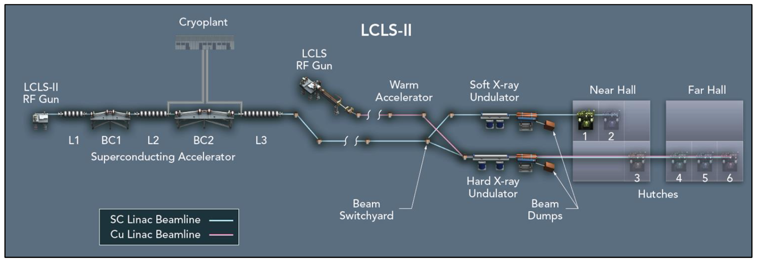
LCLS Diagram
4km / 2.5mi

Slide 4



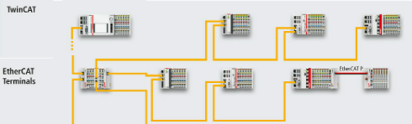
Beckhoff
Majority of controls designs are based on Beckhoff embedded controller and associated industrial hardware
Real time computing - high reliability, robust
EtherCAT fieldbus: fast, flexible,
expandable and easily configurable
I/O terminals: modular, compact, economical
EPICS
ADS (Automation Device Specification)
Beckhoff communication interface over TCP/IP
Controls devices over the network
Allows access to all PLC variables

Slide 5
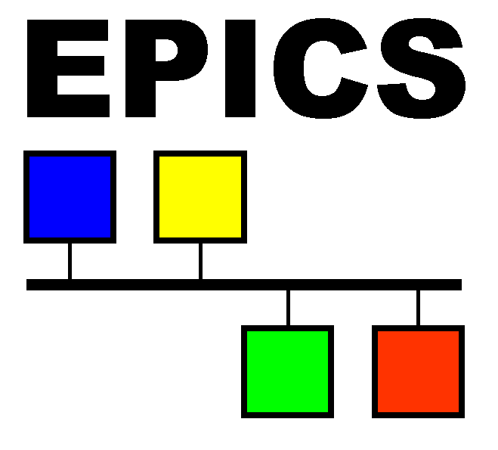

Beckhoff Integrated Subsystems
Subsystems
Vacuum
Motion
EPS/MPS
Sample delivery
Beckhoff Control System Components
EPICS
ADS Deploy
Logging and monitoring
python, pydm

Slide 6
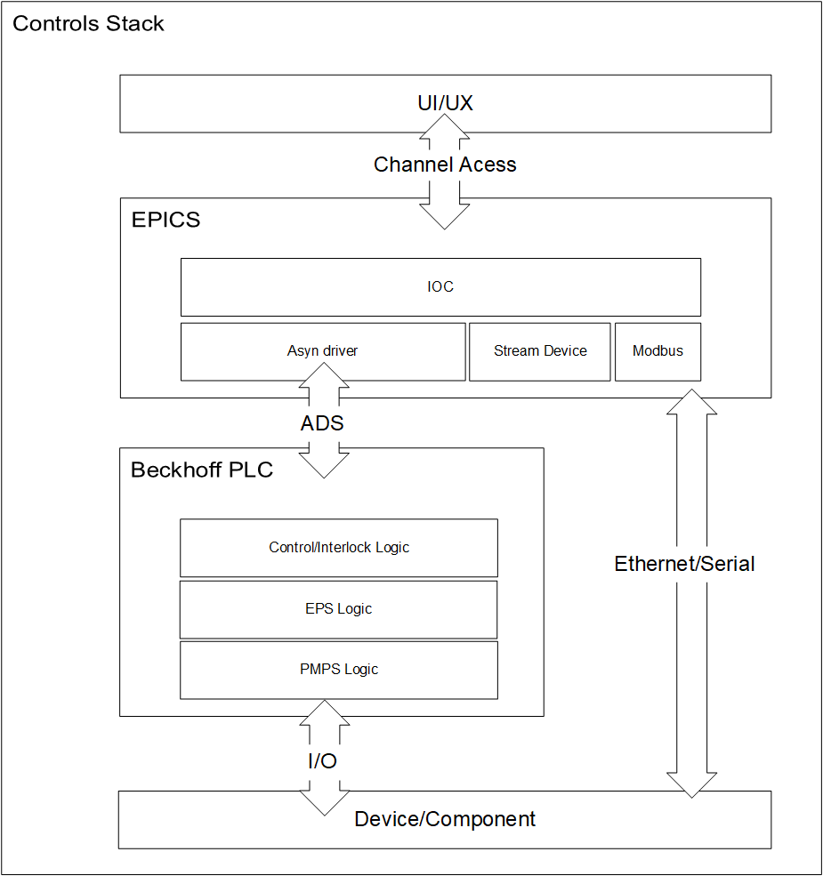
Vacuum Architecture
UI/UX PyDM/Qt widgets
Ophyd Python classes
EPICS interface
Beckhoff Communication interface with EPICS (ADS)
Beckhoff PLC Libraries and function blocks implemented and unit tested
Device/Controller interface with Beckhoff PLC

Slide 7
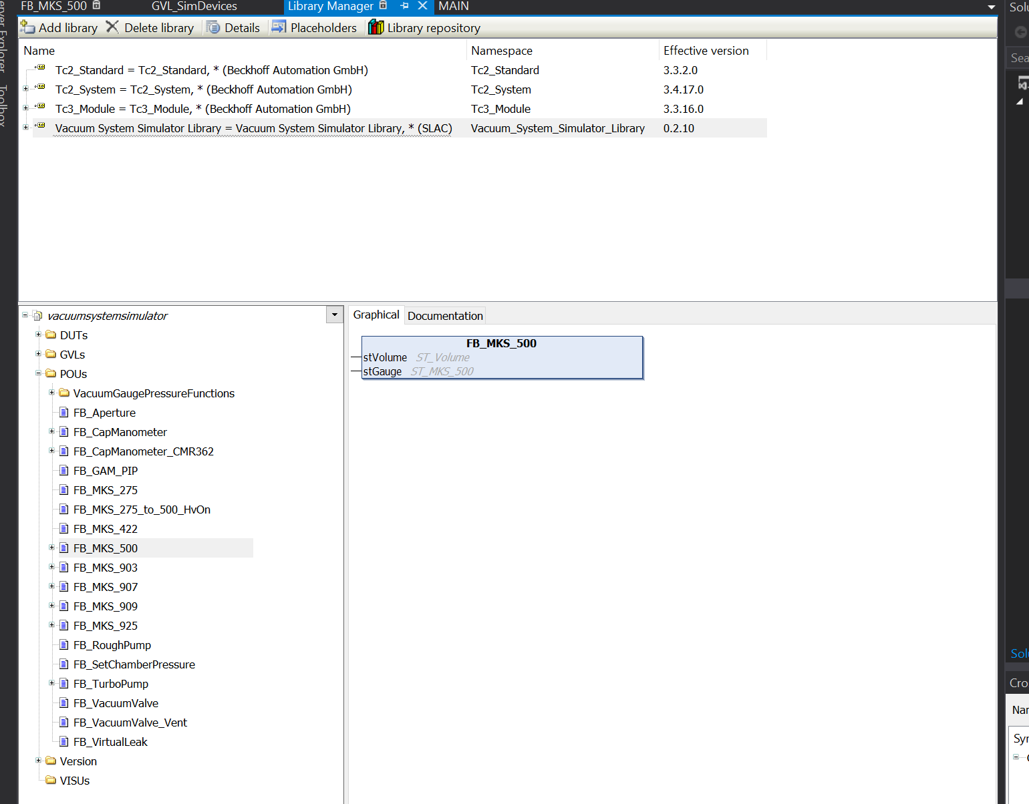
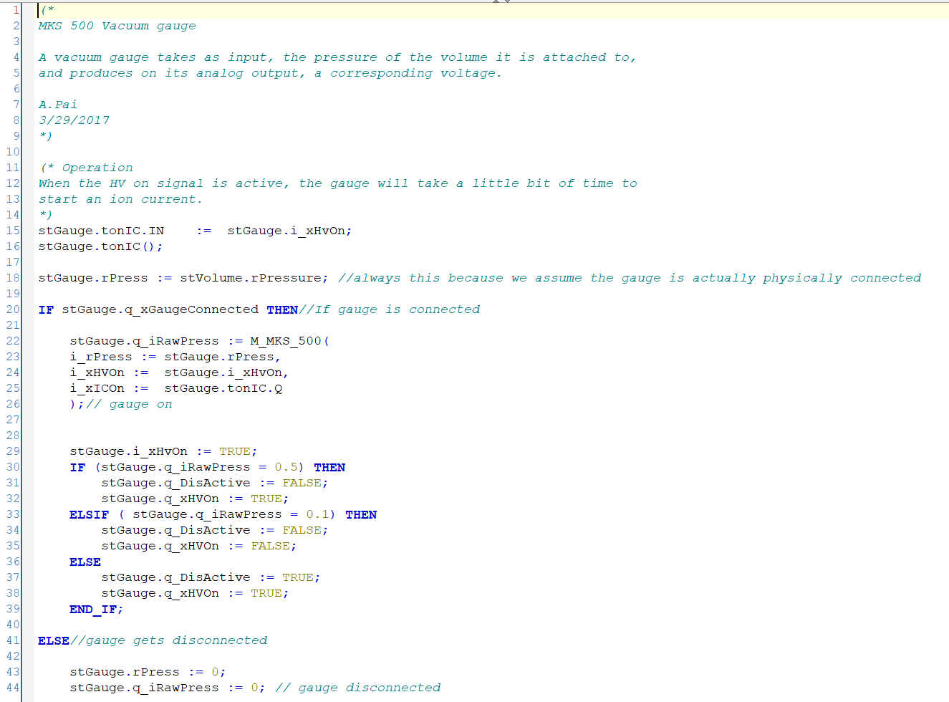
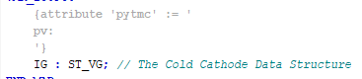
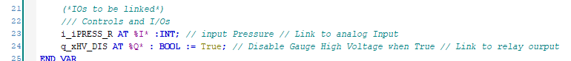
Vacuum Library
Basic operational functionality and interlocks are implemented in the PLC
Bundle data and logic together as a single unit
Structure includes all device PV/data
All I/O definitions
Protection/run logic
PLC variable tagging
Logging

Slide 8
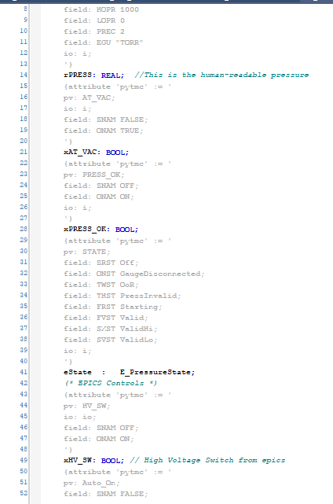
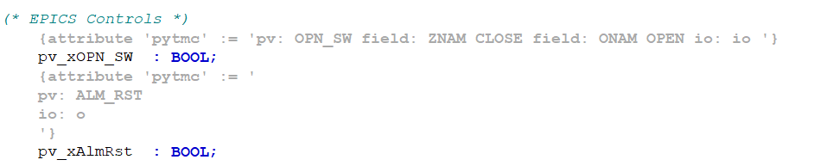
EPICS - ADS Deploy and Pytmc
Automates and simplifies accessing PLC variables through EPICS
Pytmc Pragmas
Tag variables and data structures of the PLC code
ADS-Deploy
pytmc pragma linting / verification
EPICS DB records are generated automatically
PLC process variable diagnostics DB file is generated automatically
https://github.com/pcdshub/pytmc
https://github.com/pcdshub/ads-deploy

Slide 9
Automated PLC IOC Generation using pytmc, ads-deploy
PLC Project
EPICS IOC Database
(*
IEC 61131-3 pragma annotating fValue
*)
{attribute 'pytmc' := '
pv: IOC:PV:NAME
'}
fValue: LREAL;
record(ai, "IOC:PV:NAME")
{
field(DESC, "fValue")
field(INP, "@asyn...")
…
}
$ pytmc db ...
Annotated PLC source code used to generate EPICS process database
No separate mapping of symbols to PV names that could get out of sync
TwinCAT project when built generates XML-format “.tmc” file
Pragma information is included along with symbol and type information
SLAC-defined “pytmc” pragma format defines PV metadata and naming
Templated startup scripts and shared IOC binaries
ads-deploy wraps the above tool to generate a templated IOC and ready it for usage

Slide 10

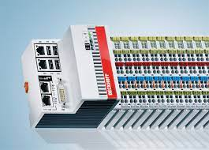
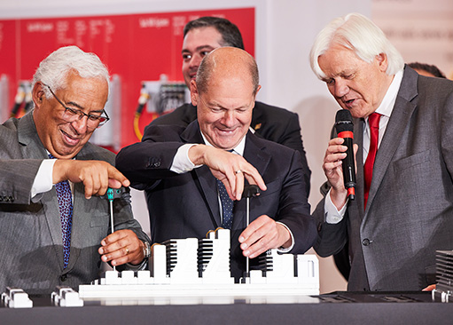


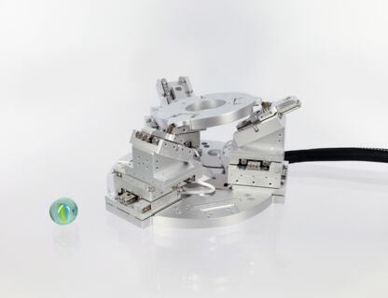

Motion Subsystem
Motion Subsystem Devices
Actuators
2-phase steppers
Piezos
DC motors
Servos
Pneumatics
Encoders
BISS-C
LVDTs
RS422

Slide 11
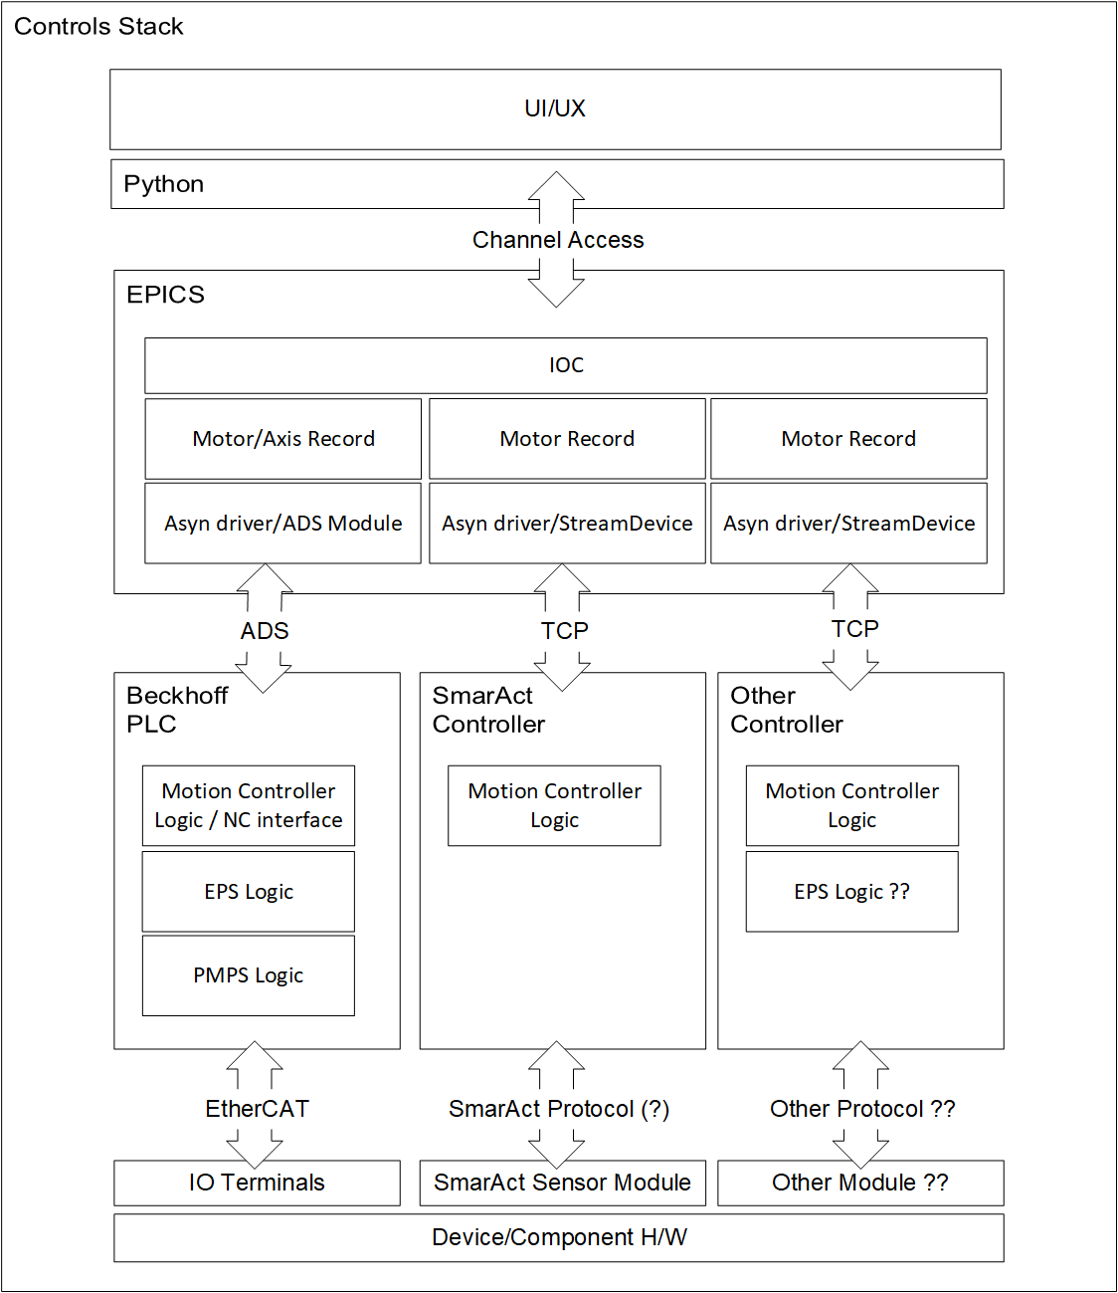
Motion Subsystem
UI/UX PyDM/Qt widgets
Ophyd Python classes
EPICS - Motor Record
Beckhoff Communication interface with EPICS - ADS
Beckhoff PLC Libraries and function blocks
Device/Controller interface with Beckhoff PLC

Slide 12
Motion Subsystem
UI/UX PyDM/Qt widgets
Ophyd Python classes
EPICS - Motor Record
Beckhoff Communication interface with EPICS - ADS
Beckhoff PLC Libraries and function blocks
Device/Controller interface with Beckhoff PLC

Slide 13
lcls-twincat-motion
Based on tc_mca_std_lib, largely unmodified (Branch).
Three modifications:
Visualizations removed due to additional dependencies (commit)
Compiler warnings fixed (commit)
MC_Power bypass (commit)

Slide 14
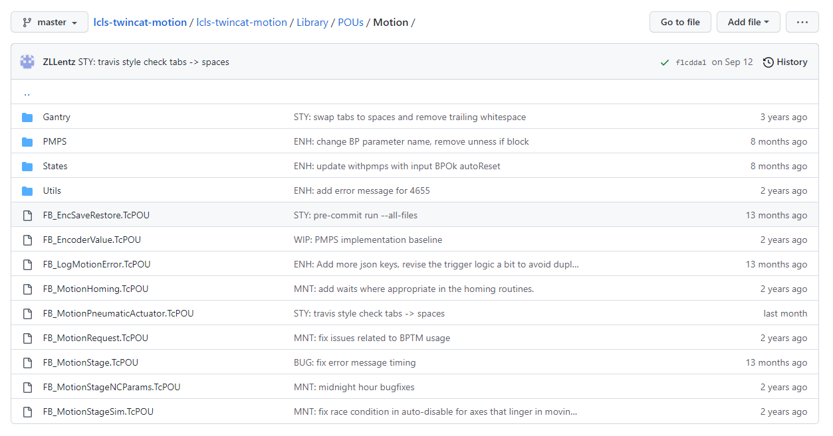
lcls-twincat-motion
DUT_MotionStage
FB_MotionStage
Provide SLAC extensions for DUT_AxisStatus and FB_DriveVirtual
https://github.com/pcdshub/lcls-twincat-motion

Slide 15
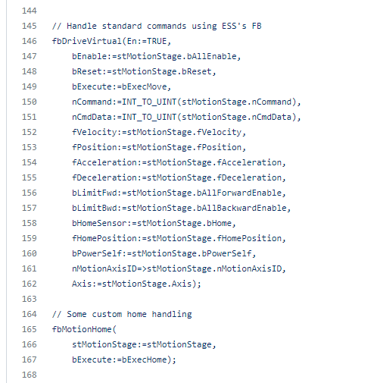
lcls-twincat-motion
FB_MotionStage in one slide:
Detect new commands
Manage HW enable logic, update enable booleans, check for errors
Call FB_DriveVirtual
Logging, error checking
Sync EPICS data via pragma’d DUT_MotionStage
Update status

Slide 16
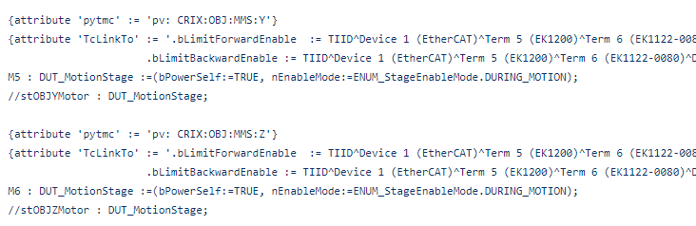
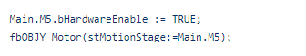
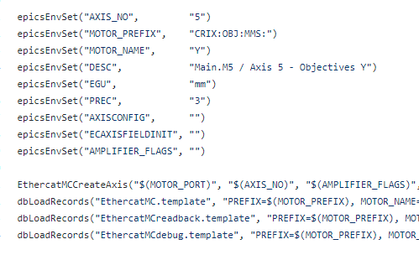
lcls-twincat-motion
Main.TcGVL
EPICS integration of un-coordinated axes becomes pretty simple:
Define and pragma a DUT_MotionStage
Instantiate FB_MotionStage, execute with reference to DUT_MotionStage
Build IOC from template using pragma’d project and ads-deploy
2. PRG_Main.TcPOU
3. st.cmd

Slide 17
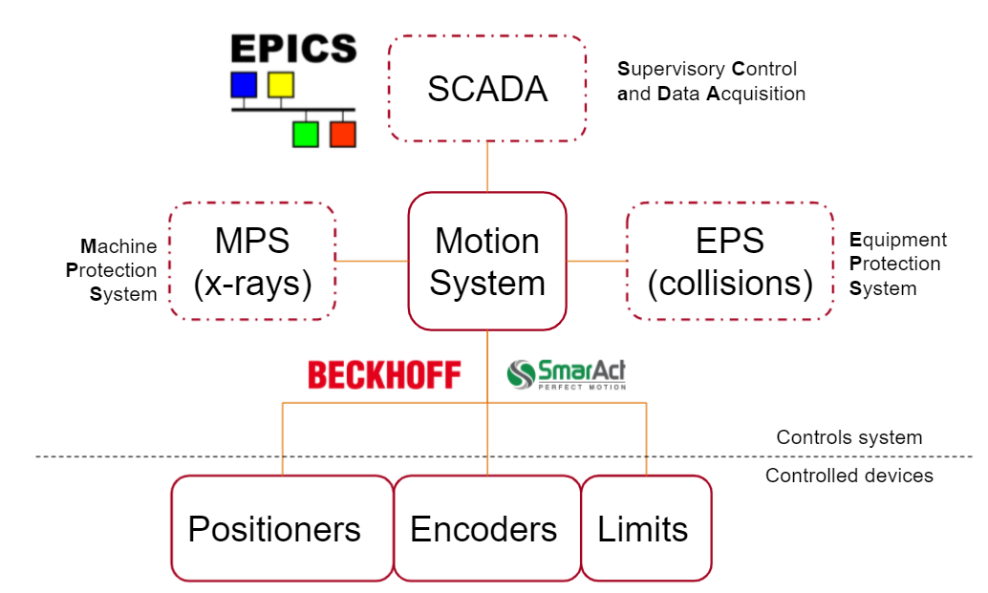
Motion EPS - MPS
Axis coordination and basic automation
EPS - Equipment Protection System
Prevent crashes, collisions, damage
PMPS Interface
Provide timely readbacks to PMPS via Beckhoff EtherCAT interface
State Mover
Prevent unsafe states preemptively
BPTM
Ensures safe beam condition before transitions.
MPS reactive fault via digital output
https://github.com/pcdshub/lcls-twincat-motion

Slide 18
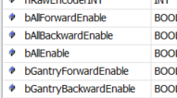
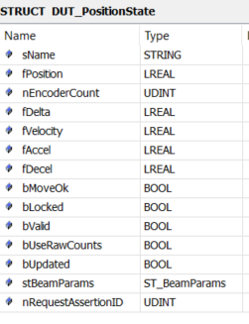
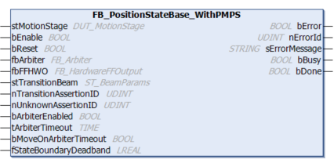
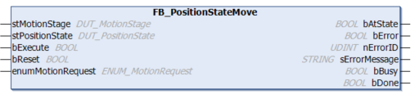
Motion EPS - MPS
Position State Mover
Virtual limits at key positions to prevent collisions
Disable forward movement
Disable backwards movement
Disable all movement and active feedback loops
Restrict motion to small adjustments at predefined setpoints to maintain safe state
https://github.com/pcdshub/lcls-twincat-motion

Slide 19
lcls-twincat-general
Catch-all library for functionality that is not project specific, or doesn’t fit under motion/vacuum subsystems
Ex: temperature sensors, flow sensors, general diagnostics, etc
Logging
FB_LogMessage allows PLC code to emit log messages
Log messages are aggregated and may be viewed via Grafana pages
https://github.com/pcdshub/lcls-twincat-general

Slide 20
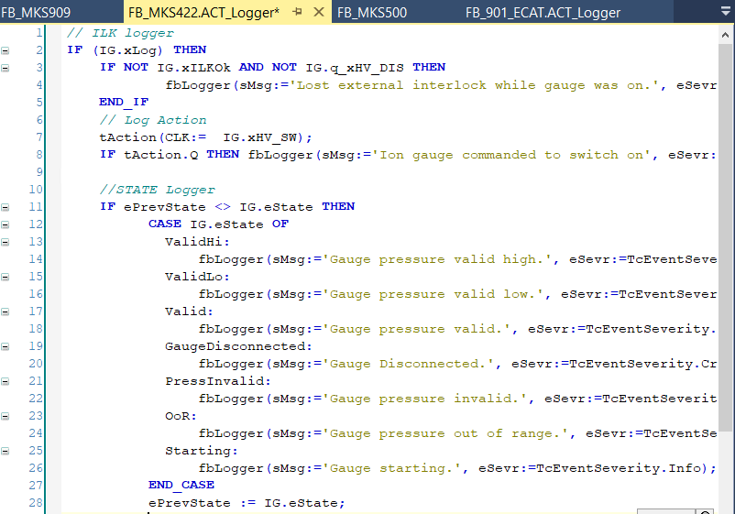
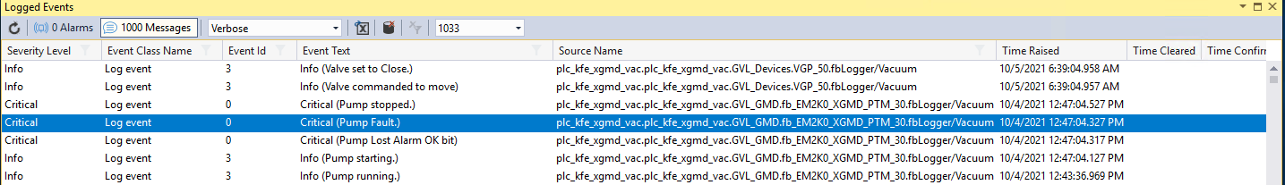
Logging Example - Vacuum
Logging functionality is fully integrated in the library code
Messages are logged every PLC cycle
Device state changes
Actions
Interlock events
https://github.com/pcdshub/lcls-twincat-general

Slide 21
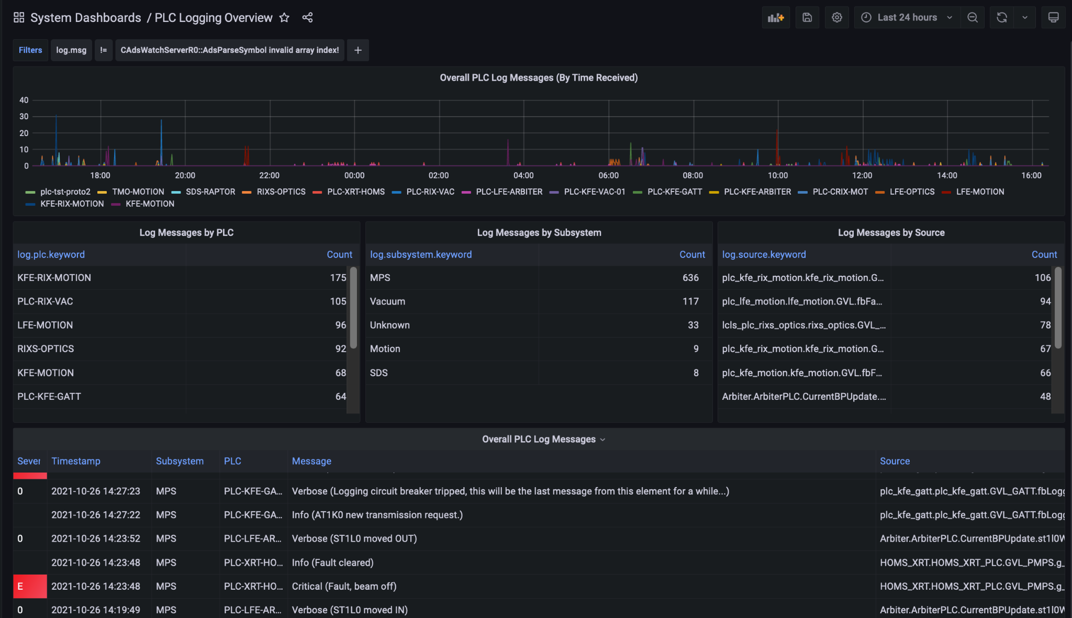
PLC Error Log Dashboard

Slide 22
m-epics-twincat-ads modifications
Upstreamed
adsSetLocalAddress
TwinCAT motion library compatibility
Our current main branch (R2.0.0-0.branch) has some commits that were not part of PRs:
Bulk reading of parameters (handle + SUMUP_READ)
Relevant commits: 1, 2
PLC-defined bulk timestamp via fixed symbol name (MAIN.fbSystemTime.time{Lo,Hi}DW)
Polling at 1 second is default
Pragmas can opt-in to notification/subscription-based updates
Absolute address fixes
Handle was being released erroneously
Exit on disconnect
Fast and repeated connections to PLC when rebooting are spammy and unnecessary
PLC reboot/crash/project activation leads to reinitialization at next IOC startup
There may be more. See the branch source for details.

Slide 23
m-epics-ethercatmc modifications
Our current main branch (R2.1.0-0.branch)
Fixes soft limit reading when disconnected (commit)
Maybe not applicable upstream: fixed (as in static) ADS port for motion axis ID (commit)

Slide 24
ads-ioc general features
PLC project and IOC startup script (not the binary) in one repository
Startup script auto-generation via pytmc/ads-deploy
Template from ads-ioc used to generate st.cmd
Additional records
Task information via records
Project / dependency information in records (new; see slide)
Automatic
Route addition (new; see slide)
Archive configuration of records (pragma-based with defaults)
Autosave configuration (pragma-based with defaults)

Slide 25
ads-ioc updates: automatic route addition
Automatic route addition at startup via prototype/toy Python library for ads communication (ads-asyn)
Developed partly with reverse engineering of the network protocol, prior to finding out about AdsTool
Going forward, we may choose to:
Switch to AdsTool
Compile in the route-adding functionality into ads-ioc
Continue improving the prototype project
st.cmd line: link
system("${ADS_IOC_TOP}/scripts/add_route.sh {{ plc_host }} {{ ioc_host_ip_regex }}")

Slide 26
ads-ioc updates: project info header
Sample link
#!/reg/g/pcds/epics/ioc/common/ads-ioc/R0.6.0//bin/rhel7-x86_64/adsIoc
################### AUTO-GENERATED DO NOT EDIT ###################
#
# Project: lcls-plc-las-bts.tsproj
# PLC name: las_bts (las_bts Instance)
# Generated using: pytmc 2.14.0
# Project version: f1c0937
# Project hash: f1c0937c92d3a07565a01b1a2a7ff4029ecc3ab6
# PLC IP/host: 172.21.160.49
# PLC Net ID: 172.21.160.49.1.1
# ** Production mode IOC **
# Using /cds/data/iocData for autosave and archiver settings.
#
# Libraries:
#
# LCLSVacuumSerialDriverLib: * -> 1.2.2 (SLAC - LCLS)
# Tc2_SerialCom: * -> 3.3.7.0 (Beckhoff Automation GmbH)
# Tc2_Standard: * -> 3.3.3.0 (Beckhoff Automation GmbH)
# Tc2_System: * -> 3.4.24.0 (Beckhoff Automation GmbH)
# Tc2_Utilities: * -> 3.3.41.0 (Beckhoff Automation GmbH)
# Tc3_Module: * -> 3.3.21.0 (Beckhoff Automation GmbH)
# TcUnit: * -> 1.1.0.0 (www.tcunit.org)
#
################### AUTO-GENERATED DO NOT EDIT ###################

Slide 27
ads-ioc updates: project info records
Sample link
dbLoadRecords("TwinCAT_Project.db", "PREFIX=PLC:LAS:BTS,PROJECT=lcls-plc-las-bts.tsproj,HASH=f1c0937,VERSION=f1c0937,PYTMC=2.14.0,PLC_HOST=172.21.160.49")
# LCLSVacuumSerialDriverLib: * -> 1.2.2 (SLAC - LCLS)
dbLoadRecords("TwinCAT_Dependency.db", "PREFIX=PLC:LAS:BTS,DEPENDENCY=LCLSVacuumSerialDriverLib,VERSION=1.2.2,VENDOR=SLAC - LCLS")
# Tc2_SerialCom: * -> 3.3.7.0 (Beckhoff Automation GmbH)
dbLoadRecords("TwinCAT_Dependency.db", "PREFIX=PLC:LAS:BTS,DEPENDENCY=Tc2_SerialCom,VERSION=3.3.7.0,VENDOR=Beckhoff Automation GmbH")
# Tc2_Standard: * -> 3.3.3.0 (Beckhoff Automation GmbH)
dbLoadRecords("TwinCAT_Dependency.db", "PREFIX=PLC:LAS:BTS,DEPENDENCY=Tc2_Standard,VERSION=3.3.3.0,VENDOR=Beckhoff Automation GmbH")
...

Slide 28

Questions?

Slide 29
Lots of backup slides

Slide 30
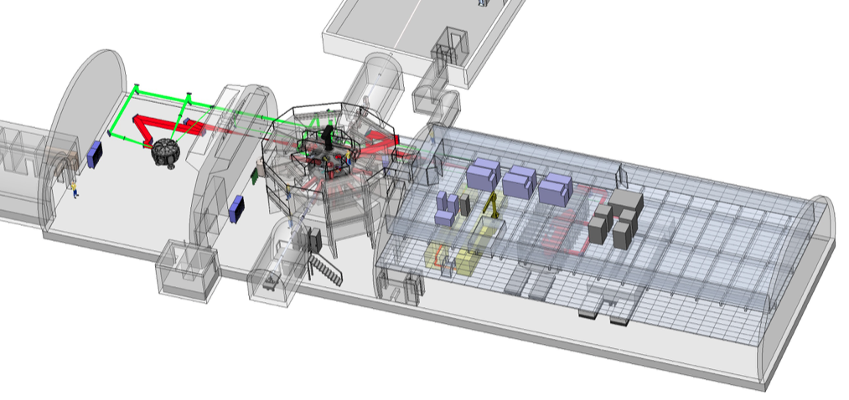


MEC Upgrade
Control Systems
LCLS ECS
Nov 17, 2021

Slide 31
LCLS Diagram
4km / 2.5mi

Slide 32
Outline
Control System Synoptic
Vacuum, Motion, EPS/MPS
Laser and Timing System
DAQ Overviews
HLA, Python, EPICS Frameworks, Archiving and Logging

Slide 33
Outline
Control System Synoptic
Vacuum, Motion, EPS/MPS
Laser and Timing System
DAQ Overviews
HLA, Python, EPICS Frameworks, Archiving and Logging

Slide 34
Control System Synoptic
We’ll start by giving a high-level overview of the control system architecture:
Control System in One Slide
Typical Controlled Devices
Typical Controller Hardware
EPICS IOCs
Switched Network
User Applications, in Brief

Slide 35
Control System in One Slide
ECS maintains a network-based distributed controls system built on top of EPICS.
A vast array of devices and controllers exist within the controls system, requiring organized and sophisticated infrastructure to keep things online.
User applications are built on shared platforms, interacting with the control system and its metadata in a uniform way.

Slide 36
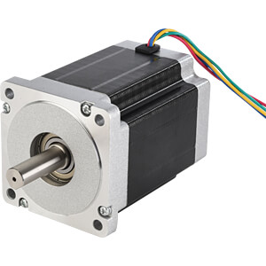
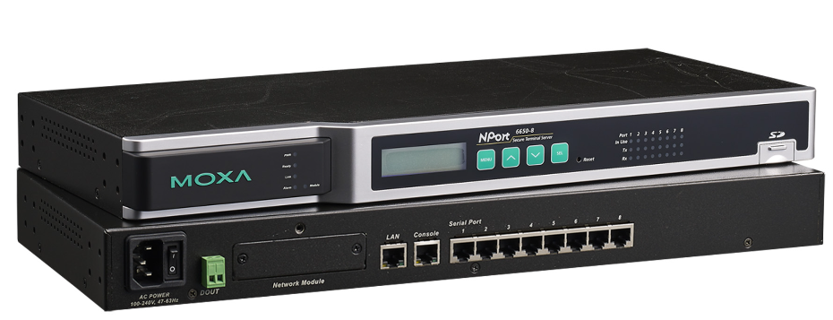

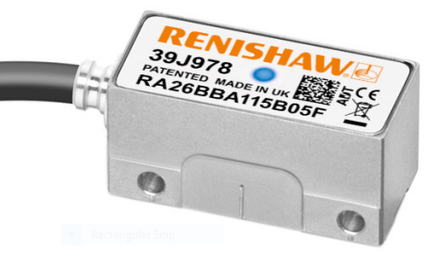
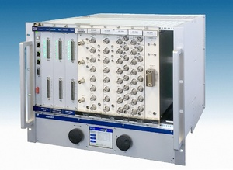

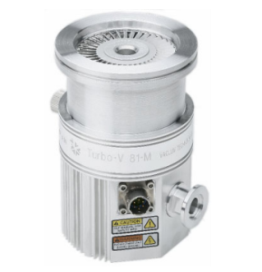
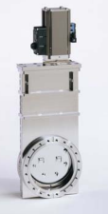
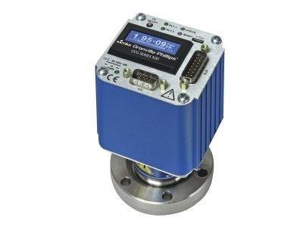
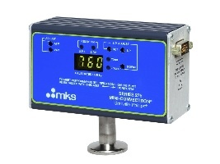
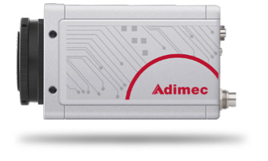
Typical Controlled Devices
Encoder Read Head
Terminal Port Server
HV Supply
Stepper Motor
Encoder Strip
Low-rate Camera
Gate Valve
Cold Cathode Gauge
Pirani Gauge
Turbo Pump
High-rate CCD

Slide 37
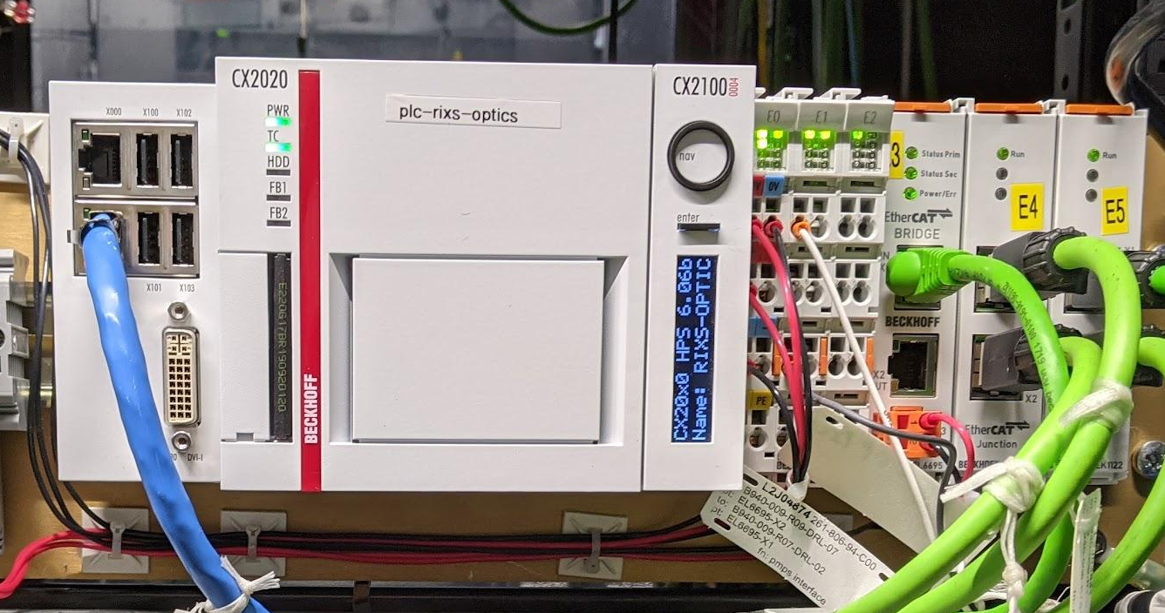
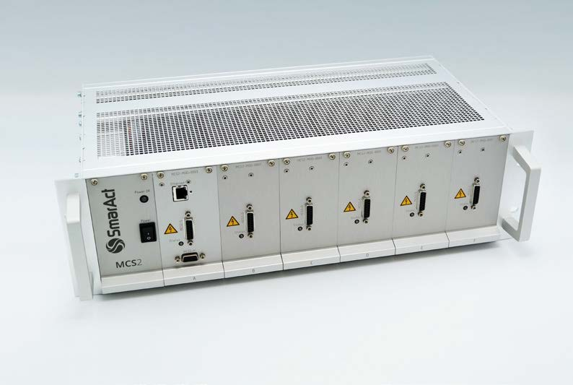
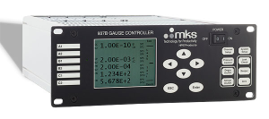
Typical Controller Hardware
Control system is primarily Beckhoff PLCs
Motion, vacuum, etc.
Other controllers used as-needed
Specialized Motion Controller
Typical Gauge Controller
An installed Beckhoff PLC

Slide 38

EPICS IOCs: Definitions
Definitions:
EPICS: the name of the control system framework
IOC: input-output controller (software)
PV: process variable (some system measurement, e.g. voltage, temperature, pressure, position)
An EPICS IOC is software that allows PVs to be read from and written to as an interface to controller hardware.

Slide 39
EPICS IOCs: Protocol
Standardized network protocol for manipulating PVs
Called “Channel Access” (newer: “PVAccess”)
On the network (simplified):
Client sends a UDP broadcast: “Who has this PV?”
Server with the PV replies: “I have this PV.”
Client and server exchange data over TCP.
Client can get data, put data, or subscribe to receive continual updates about changes to the data.
“Data” may include values, metadata, and timestamps.

Slide 40
EPICS IOCs: Drivers
In the driver (simplified):
Read from controller, put data into PV
Write to controller based on user data in PV
Generic drivers exist for specific common protocols like serial communication, modbus, Beckhoff PLC ADS, etc., that can be configured for each device.
Similar devices (e.g. motors, cameras) have standard EPICS APIs to adhere to, defined in shared modules.
Specialized devices will need custom EPICS drivers.

Slide 41
EPICS IOCs: Interface Architecture
IOC runs on a server and typically (but not exclusively) communicates with devices over the network.
Network Switch
Network Switch
IOC/CTL Host
IOC/CTL Host
Client Host
IOC
IOC
IOC
EPICS-aware Software
Controller
Controller
Camera

Slide 42
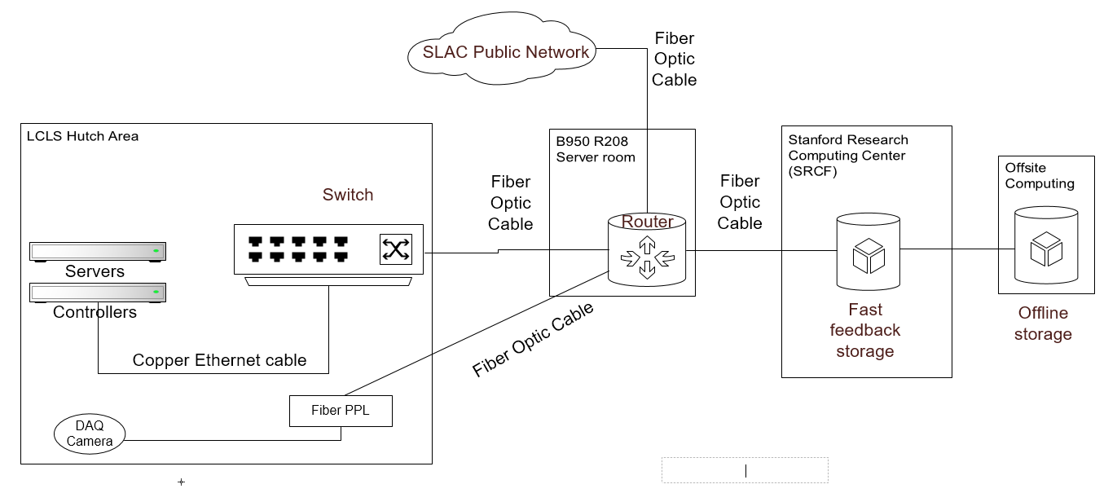
Switched Network Architecture

Slide 43
User Applications, in Brief
LCLS uses many applications build on top of EPICS.
About half of these come from the EPICS community, and the other half were developed in-house.
Two categories:
Native applications
Web applications

Slide 44
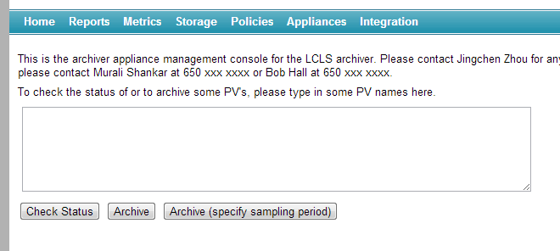

Applications: Archiver Appliance
The Archiver Appliance is a service that records the EPICS PVs in our controls system as they change.
Data from the archiver can be accessed via a simple HTTP requests and used in other applications

Slide 45
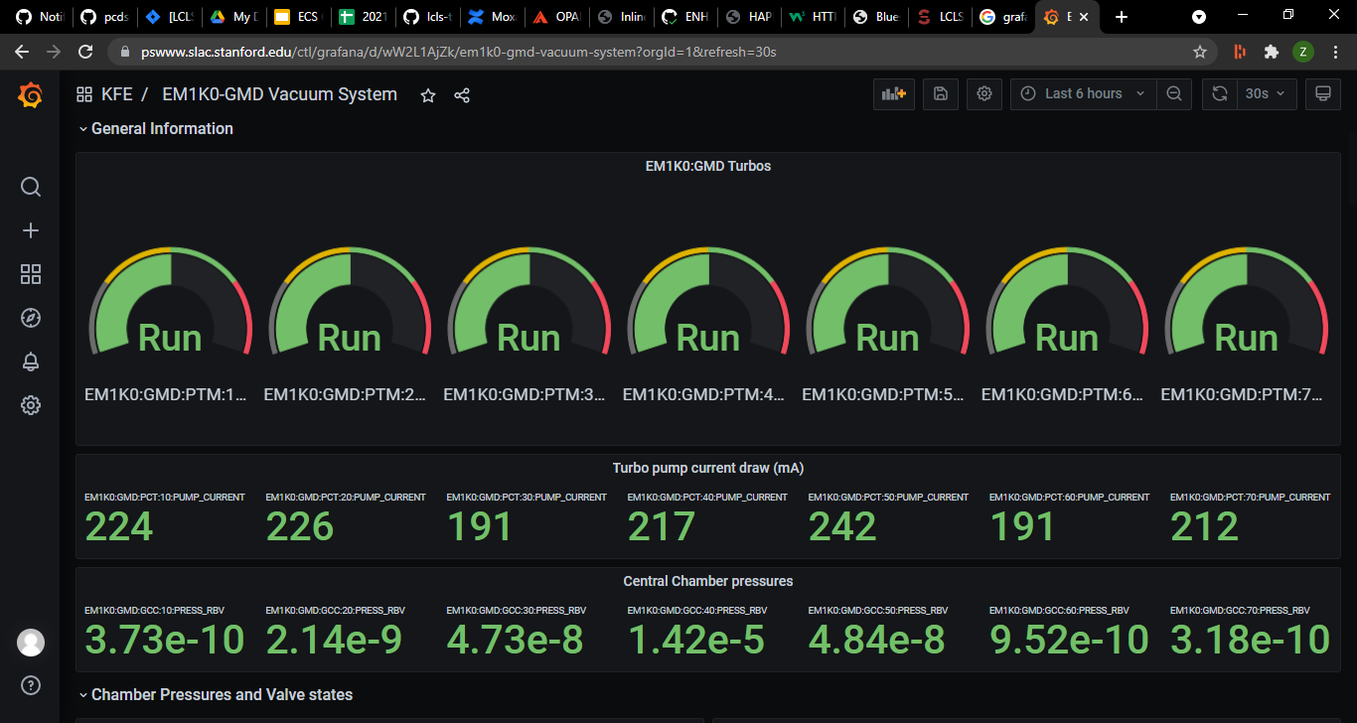
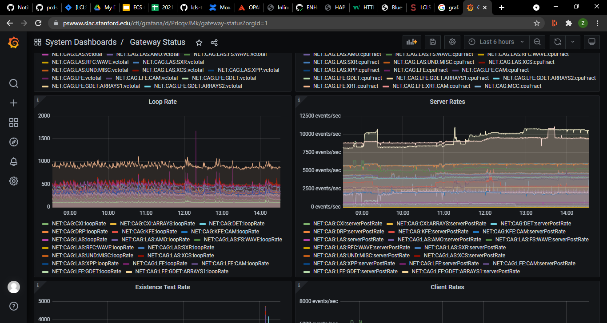
Applications: Grafana
Grafana is a web application tailored to visualizing time-series data.
Can read data from the archiver.
Can view and edit these displays from a standard web browsers (values are read-only).
Can correlate EPICS events with other system logs.

Slide 46
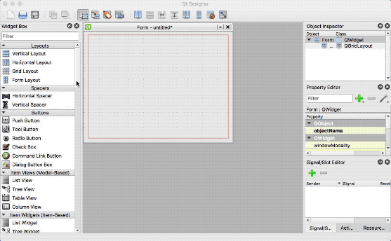
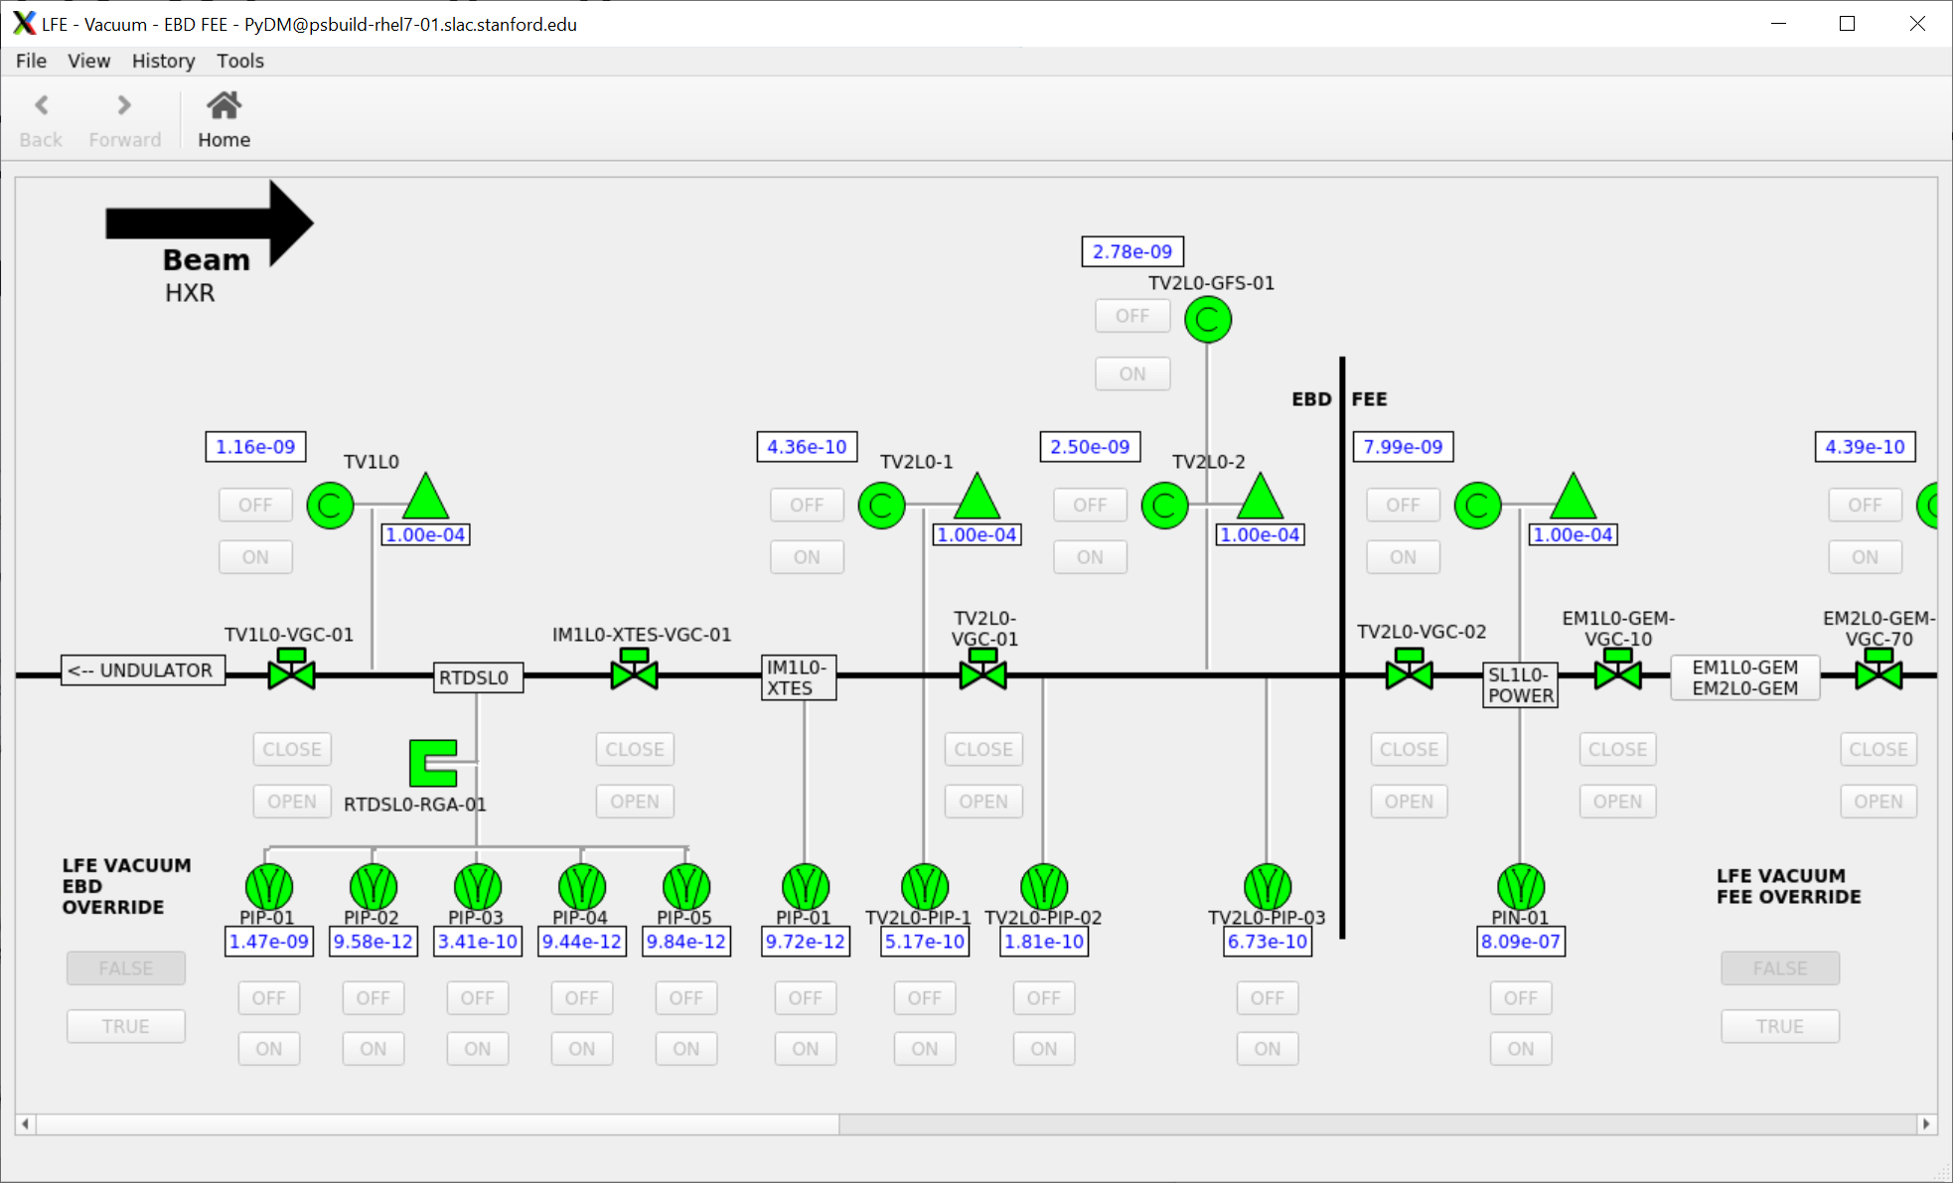
Applications: PyDM
PyDM is a framework for including and showing EPICS data inside of PyQT applications.
Can drag/drop widgets to make a UI or use the libraries to create procedurally generated displays.

Slide 47
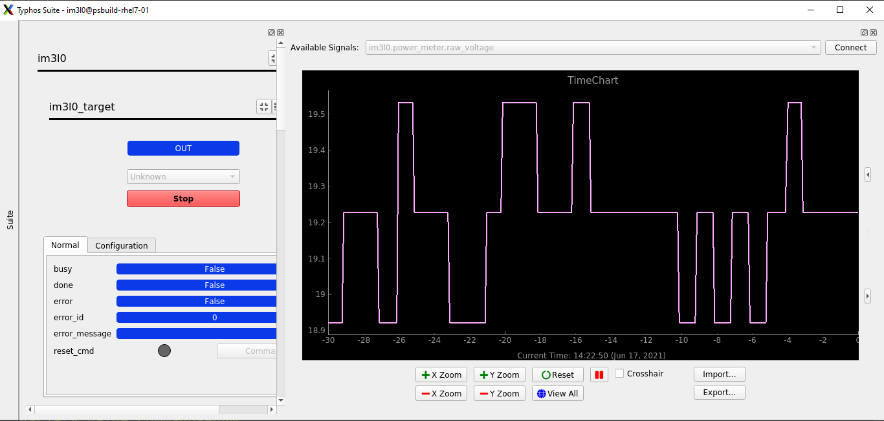
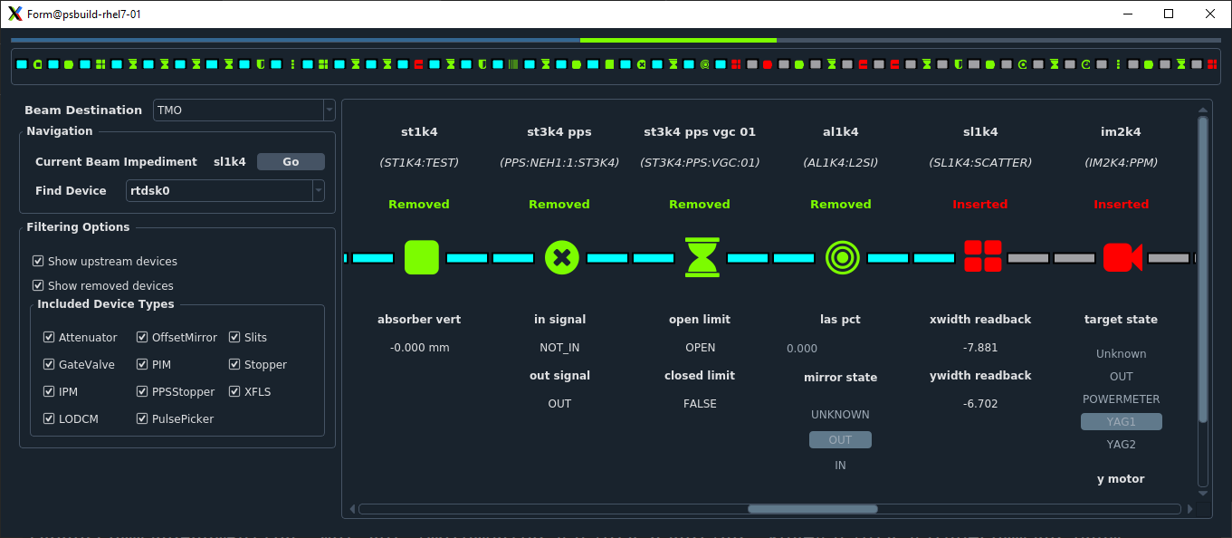
Applications Built on PyDM
Typhos
Generate device screens automatically from a database
Provide a launcher for device screens
LUCID
Generate home screens automatically from a database
Lightpath
Understand the status of beamline devices and if they are blocking the x-ray beam

Slide 48
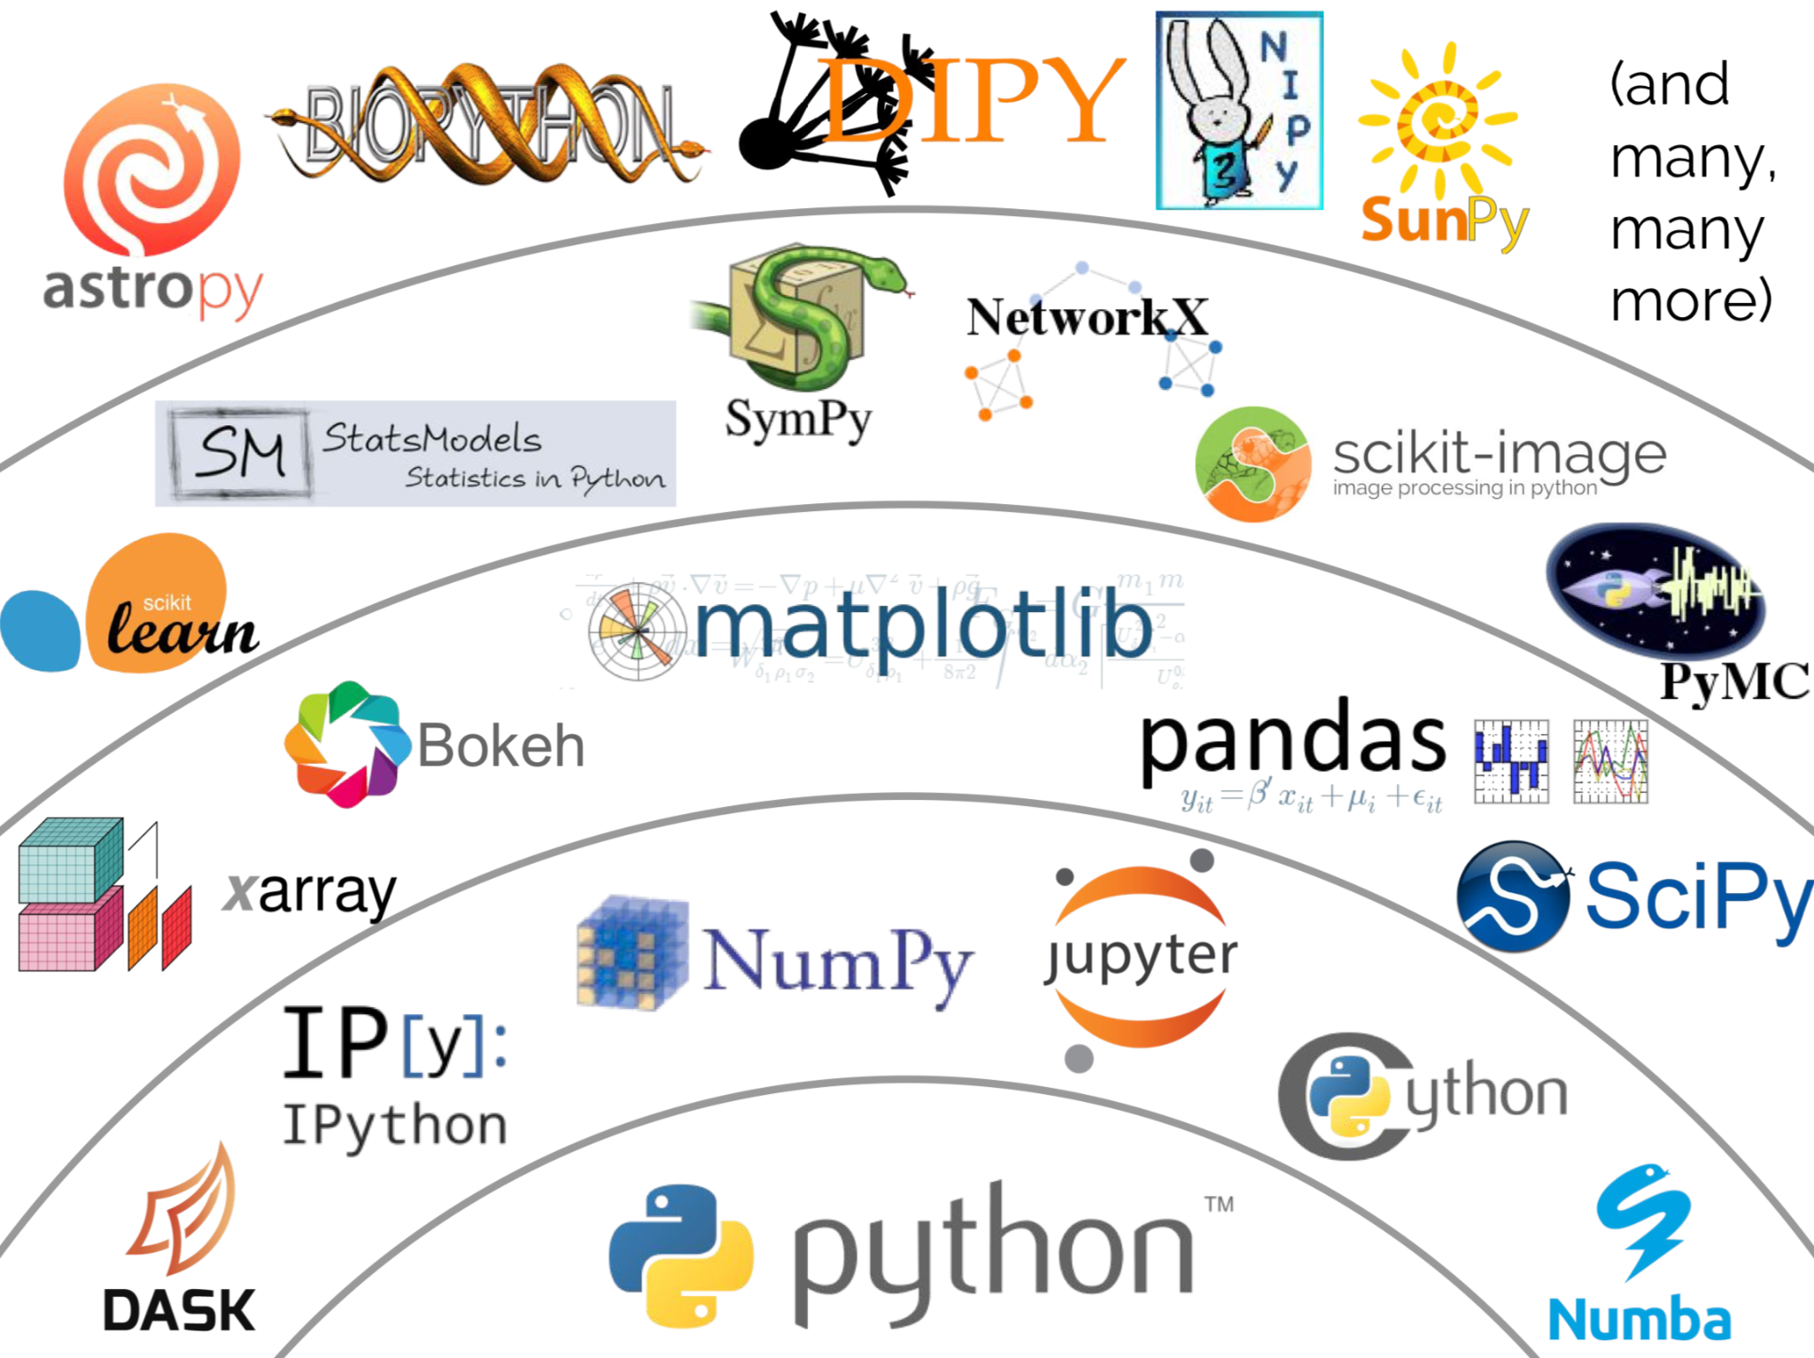
Hutch Python
IPython session for controlling experiments
User can script data collection routines via the DAQ and control beamline components via EPICS
Uses the lab community bluesky and ophyd packages, connects to all of our existing infrastructure

Slide 49
Outline
Control System Synoptic
Vacuum, Motion, EPS/MPS
Laser and Timing System
DAQ Overviews
HLA, Python, EPICS Frameworks, Archiving and Logging

Slide 50
Controls Architecture and Subsystems
Subsystems
Vacuum
Motion - EPS
MPS
Controls Stack
EPICS
ADS Deploy
Logging and monitoring
python, pydm

Slide 51
Controls Architecture and Subsystems
Subsystems
Vacuum
Motion - EPS
MPS
Controls Stack
EPICS
ADS Deploy
Logging and monitoring
python, pydm

Slide 52
Beckhoff PLC
Controls designs are based on Beckhoff embedded controller and associated industrial hardware
Real time computing - high reliability , robust
EtherCAT fieldbus: Fast, Flexible,
expandable and easily configurable
I/O terminals: Modular, Compact, Economical
EPICS
ADS (Automation Device Specification)
Beckhoff communication interface over TCP/IP
Controls Devices over the network
Integration with EPICS
Allows access to all PLC variables

Slide 53
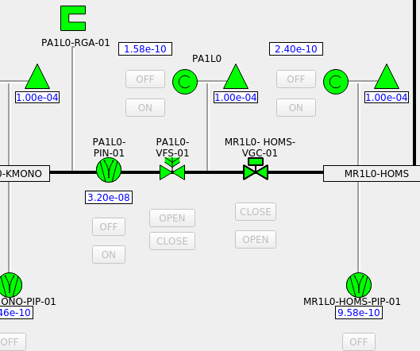
Vacuum Subsystem
Vacuum interface directly with various vacuum devices to provide basic operational functionality and interlocks
Digital IO, Analog IO, Serial Interface
Interlocks and EPS
Gauges that may suffer performance degradation when switched on at high pressure have protection setpoints.
Ion pumps are interlocked so they won’t be switched on at high pressure.
Turbo pumps Interlocks (backing pressure and inlet pressure)
Valves Interlock Setpoint
PMPS and MPS interface

Slide 54
Vacuum Architecture
UI/UX widgets
Ophyd devices.
EPICS interface.
Beckhoff Communication interface with EPICS (ADS).
Beckhoff PLC Libraries and function blocks implemented and tested.
Device/Controller interface with Beckhoff PLC.

Slide 55
Vacuum Architecture
UI/UX widgets
Ophyd devices.
EPICS interface.
Beckhoff Communication interface with EPICS (ADS).
Beckhoff PLC Libraries and function blocks implemented and tested.
Device/Controller interface with Beckhoff PLC.

Slide 56


Device Component - IO
MKS500 - Gauge
Cable
pinouts
signals
connectors
cable type
Beckhoff terminals
control
readbacks

Slide 57


Beckhoff PLC - IO
H/W Test and checkouts
Test Boxes for most supported device along with test procedures to verify the cables.
Also checks and unit IO tests to verify the wires are installed according to the EPLAN drawings.

Slide 58
Vacuum Architecture
UI/UX widgets
Ophyd devices.
EPICS interface.
Beckhoff Communication interface with EPICS (ADS).
Beckhoff PLC Libraries and function blocks implemented and tested.
Device/Controller interface with Beckhoff PLC is well defined.

Slide 59
Vacuum Library
Basic operational functionality and Interlocks are implemented in the PLC
Bundling data and logic together as a single unit.
Structure includes all device PV/data
All I/Os definitions
Protection/Run Logic
PLC variable tagging.
Logging.

Slide 60


Vacuum Library - Unit testing
Test functionality of most common vacuum devices Function block
Ensures all the devices’ code is tested
Ensures any modifications to existing device didn’t break basic functionality and interlocks
Reduce deployment time for future library releases
Example : Cold Cathode Gauge
Reads voltage and calculates a pressure
Assign state based on the pressure calculation
Sets/Reset interlock bit
Log status
https://github.com/pcdshub/lcls-twincat-vacuum

Slide 61
Vacuum Architecture
UI/UX widgets
Ophyd devices.
EPICS interface.
Beckhoff Communication interface with EPICS (ADS).
Beckhoff PLC Libraries and function blocks implemented and tested.
Device/Controller interface with Beckhoff PLC is well defined.

Slide 62
EPICS - ADS Deploy and Pytmc
Based on Beckhoff PLC open communication protocol (ADS).
Automates and simplifies accessing PLC variables through EPICS.
Pytmc Pragmas
Tag variables and data structures of the PLC code
ADS-Deploy
pytmc pragma linting / verification
EPICS DB records are generated automatically
PLC process variable diagnostics DB file is generated automatically
https://github.com/pcdshub/ads-deploy

Slide 63
EPICS - Device Driver
Non Interlock critical process variables are directly interfaced through EPICS.
Configuration variables
Device meta-info
Long-term device health/ status variables, monitored by our alert system
This interface will be achieved via TCP/IP, Modbus or RS232/485.
Serial interfaces through MOXA terminal servers
EPICS device drivers:
MKS937A/B - RS232
QPCe - Ethernet
Twistorr turbo pumps - Serial
...

Slide 64
Vacuum Architecture
UI/UX widgets
Ophyd devices.
EPICS interface.
Beckhoff Communication interface with EPICS (ADS).
Beckhoff PLC Libraries and function blocks implemented and tested.
Device/Controller interface with Beckhoff PLC is well defined.

Slide 65




EPICS - pcdsdevices and pydm pcdswidgets
https://github.com/pcdshub/pcdsdevices
https://github.com/pcdshub/pcdswidgets

Slide 66
Logging
Logging functionality is fully integrated in the library code
Messages are logged every PLC cycle.
Device state changes.
Actions.
Interlock events.
https://github.com/pcdshub/lcls-twincat-general

Slide 67
Controls Architecture and Subsystems
Subsystems
Vacuum
Motion - EPS
MPS
Controls Stack
EPICS
ADS Deploy
Logging and monitoring
python, pydm

Slide 68

Motion Subsystem
Motion controls architecture
Integration of all motion devices all the way to EPICS.
Actuators:
2-phase steppers (64x microstepping)
DC motors
Servos
Piezos
Pneumatics
Encoders
BISS-C, LVDTs, RS422
Controllers: Beckhoff, Aerotech Ensemble, SmarAct MCS2, PI

Slide 69
Motion Subsystem
UI/UX widgets.
Ophyd devices.
EPICS - Motor Record.
Beckhoff Communication interface with EPICS - ADS .
Beckhoff PLC Libraries and function blocks .
Device/Controller interface with Beckhoff PLC.

Slide 70
Motion EPS - MPS
Axis coordination and basic automation
EPS - Equipment Protection System
Prevent crashes, collisions, damage
PMPS Interface
Provide timely readbacks to PMPS via Beckhoff EtherCAT interface
State Mover
Prevent unsafe states preemptively
BPTM
Ensures safe beam condition before transitions.
MPS reactive fault via digital output
https://github.com/pcdshub/lcls-twincat-motion

Slide 71
Motion EPS - MPS
Position Sate Mover
Virtual limits at key positions to prevent collisions.
Disable forward movement
Disable backwards movement
Disable all movement and active feedback loops
Restrict motion to small adjustments at predefined setpoints to maintain safe state.
https://github.com/pcdshub/lcls-twincat-motion

Slide 72

PMPS Subsystem
PMPS ensures that all beamline components are gated by the beam state.
Distributed system for monitoring beamline device states, and reacting quickly to unsafe conditions.
Framework for implementing photon beamline device state machines that ensure the beamline device is protected prior to beginning any transition.
An Arbiter automatically condition the beam so a requested device state can be reached safely
Transmission (gas and solid attenuators)
Beam class (asserted through a PMPS to AMPS interface), essentially beam rate
Photon energy range
Apertures
The arbiter PLC communicates the requested assertion beam to an ATCA crate and/or communicates the requested Transmission or Aperture size to appropriate PLC.

Slide 73
Controls Architecture and Subsystems
Subsystems
Vacuum
Motion - EPS
MPS
Controls Stack
EPICS
ADS Deploy
Logging and monitoring
python, pydm

Slide 74

PMPS Subsystem
PMPS ensures that all beamline components are gated by the beam state.
PMPS utilizes PLC controllers integrating various actuators, vacuum transducers, absolute encoders, dry-contact switches, flowmeters, and temperature sensors to control to monitor device states and beam parameters through the EtherCAT network.
Preemptive and reactive elements are kept separate.
Dedicated interface to the MPS Link node for active beamclass selection.
PLC code library framework for implementing new devices, transitions and arbitrations.
https://github.com/pcdshub/lcls-twincat-pmps

Slide 75

PMPS Subsystem
Distributed controls system for monitoring beamline device states connected over EtherCAT network.
Arbiter automatically condition the beam so a requested device state can be reached safely.
An Arbiter receives safe parameters set over EtherCAT.
The arbiter PLC communicates the requested assertion beam to an MPS Link node.
The arbiter PLC communicates the requested parameters to a PLC that has control over those parameters.
Beam parameters are continuously broadcasted over EtherCAT network.

Slide 76
PMPS Subsystem
Distributed controls system for monitoring beamline device states connected over EtherCAT network.
Arbiter automatically condition the beam so a requested device state can be reached safely.
An Arbiter receives safe parameters set over EtherCAT.
The arbiter PLC communicates the requested assertion beam to an MPS Link node.
The arbiter PLC communicates the requested parameters to a PLC that has control over those parameters.
Beam parameters are continuously broadcasted over EtherCAT network.

Slide 77

PMPS Subsystem
https://github.com/pcdshub/pmps-ui

Slide 78

PMPS Subsystem

Slide 79
Controls Architecture and Subsystems
Subsystems
Vacuum
Motion - EPS
MPS
Controls Stack
EPICS
ADS Deploy
Logging and monitoring
python - pydm

Slide 80
Outline
Control System Synoptic
Vacuum, Motion, EPS/MPS
Laser and Timing System
DAQ Overviews
HLA, Python, EPICS Frameworks, Archiving and Logging

Slide 81
Lasers and Timing
Goal: spatial/temporal overlap between X-rays and optical laser at the interaction point (I.P.)
Also: control pulse energy, pulse length, wavelength, spatial profile, temporal profile…
Distributed systems
Sector 10 → I.P. (timing)
Laser hall → I.P. (lasers)
Coordinated systems

Slide 82



LCLS-I Lasers
LCLS-I: Very few controls
Largely commercial laser systems: Coherent, etc.
Vendor LabVIEW control system
Strategically placed controls
Motors
Cameras/Diagnostics
Often used manually inserted diagnostics

Slide 83











LCLS-II Lasers
Designed to be operated completely remotely
EPICS integration
Motorization
Diagnostics
Goal: enable non-experts to operate the laser systems
Automation
High level control

Slide 84

LCLS-II Lasers

Slide 85

LCLS-II Lasers - Laser Hall

Slide 86



LCLS-II Lasers - Laser Switch Box

Slide 87
LCLS-II Lasers - MODS
Modular Optical Delivery System - M.O.D.S.
Composed of Tabletop Interchangeable Laser Elements - T.I.L.E.s
Common platform TILEs stay with a hutch
Experiment TILEs change depending on experiment needs
From B.T.
Injection
ATM Feed
Compressor
Vis OPA
Ejection
Common Platform TILEs
To L.I.C.
Experiment TILEs

Slide 88

LCLS-II Lasers - MODS

Slide 89

LCLS-II Lasers - MODS

Slide 90


LCLS-II Lasers - MODS

Slide 91

LCLS-II Laser System - Happi Database
Happi: database for beamline devices
Auto-instatiates devices in beamline python
Adds devices to auto-generated LUCID homescreens
Metadata from Happi can be used to (re-)build TILE IOCs

Slide 92

LCLS-II Laser System - LUCID Homescreen

Slide 93
LCLS Timing - What’s it for?
Coordinating devices across the facility
LINAC structures need to know when the beam is arriving to ramp up parts of the accelerator, prepare diagnostics, etc.
Optical lasers on the photon side need to sync up with the X-rays to achieve temporal overlap
DAQ needs to occur in sync with the X-rays to capture experimental data in sync with both of the above

Slide 94
LCLS-I Timing
Two clocks: “fiducials”, and “ticks”
Fiducials
Derived from 360 Hz facility power
Phase zero crossings create 6 coarse buckets (“timeslots”) that triggers fall in to
Ticks
119 MHz pulses, derived from 476 MHz reference
Fine timing control (8.4 ns/tick)
Combine the above into “Event” timing system

Slide 95

LCLS-I Timing - Events and the EVG
“Event” based timing system
Event codes generated by EVG (EVent Generator) in a timing data stream
Some codes are always present, others are conditional
EVG creates a constant stream of event frames, synchronous with the linac

Slide 96

LCLS-I Timing - EVRs
EVent Receivers
PCIe cards running SLAC firmware
Parse the timing data stream and generate up to 12 LVTTL HW triggers
Configurable polarity, pulse width, and delay
EVR channels can be used by IOCs for timestamping

Slide 97

LCLS-I Timing - A high level overview
LVTTL Triggers
EVR
Device
Fiber
Fanout
360 Hz
EVG
...
Device
119 MHz
...

Slide 98

LCLS-I Timing - Sequencer
Allows creation of custom event sequences
Codes can be delayed relative to each other, and to a sync marker
Used to execute more complex experiments/DAQ
Used by MEC to coordinate the lasers, pulse picker, and many diagnostics w.r.t. the X-rays

Slide 99

LCLS-I Timing - MEC SPL (c/o Eric Cunningham)
EVRs combined with SRS DG645 (EPICS integrated) delay generators for increased resolution and flexibility
SPL: use up to 4 different groups of event codes to trigger the laser and related hardware

Slide 100



LCLS-II Timing - Pulsed Fiber Timing System
PFTS from Cycle
LCLS-II Timing System
TCBOC signals in timing lab

Slide 101
Outline
Control System Synoptic
Vacuum, Motion, EPS/MPS
Laser and Timing System
DAQ Overviews
HLA, Python, EPICS Frameworks, Archiving and Logging

Slide 102

DAQ Overview
System separate to deal with large amounts of timestamped data
MEC-U will use the LCLS-II data system

Slide 103


DAQ Overview - continued
all processes started (and stopped) in unison
‘master’ control process
tightly coupled to timing system
look & analyze data in real time

Slide 104


ami-examples

Slide 105
DAQ & controls
slow: current at ~1 Hz (epicsArchiver)
faster: need direct connection to the DRP layer
tested at up 120 Hz
PVs need to be time-stamped so data can be matched
(see next slide)
EPICS used for feedback from DAQ to automation later
(step) scans: we save controls/other data about the conditions in a scan with the DAQ data in a specific data type (ControlData)
this information is also shown in the elog

Slide 106
DAQ - detector support (slide borrowed)
Detector readouts currently exercised in experiments or the teststand
Timing system
High speed digitizer
Wave8 ADC
Opal1000
Piranha4 (TimeTool)
Pvcam (Andor, XTCAV) [external devices via EPICS]
EpicsArch (asynchronous EPICS retrieval)
BLD (e-beam, hps [PCAV, GMD, XGMD])
New detector support requires
Timing interface integration [TTL/direct/data]
Data readout interface integration [CamLink/PGP/… to KCU1500 or other(EPICS)]
DRP software [configuration descr, event data descr]
Psana detector interface [calibration,geometry]

Slide 107

DAQ & Elog
DAQ & elog are integrated: runs are automatically entered with information about detectors used & EPICS PVs at run start
you can add information later after analysis
all of this information can be used in making tables or simple plots
we can also start data processing jobs automatically
for all runs with tunable delays
you can specify conditions (e.g. single out calibration runs)

Slide 108



DAQ & Elog
we can also start data processing jobs automatically
for all runs with tunable delays
you can specify conditions (e.g. single out calibration runs)

Slide 109
Outline
Control System Synoptic
Vacuum, Motion, EPS/MPS
Laser and Timing System
DAQ Overviews
HLA, Python, EPICS Frameworks, Archiving and Logging

Slide 110
HLA, Python, EPICS Frameworks, Achiving and Logging
EPICS Infrastructure
High-level applications (HLAs)
Python libraries and infrastructure
Archiving EPICS data
Centralized logging system
Grafana

Slide 111


Two minute introduction to EPICS

Slide 112

The architecture of EPICS
The distributed nature of EPICS means that clients and servers can interact with one another so long as they are accessible over the network.
This communication happens over the Channel Access protocol.

Slide 113
EPICS PVs
Each server has its own database of information, the smallest piece of which you can query is called a Process Variable (PV)
Identified by a string (e.g., “BPM-01:X”)
Can hold simple scalar values, or arrays of scalars
Metadata associated with each PV
Timestamp
Alarm information
Units
Control limits
Clients can easily query all servers at once: “Who has BPM-01:X”?
And then talk directly with the server that owns the PV to get, put, or monitor it

Slide 114
A sample Channel Access client/server session
CA Client
search request
caget
caput
camonitor
Change its value to 30.5, please
Notify me whenever the value changes
Who has a PV named “HVAC:Setpoint”?
What is its value?
Channel Access Client
I do.
25.5 C
OK, it is now 30.5 C
20.5 C
19.5 C
18.5 C
Channel Access Server
Process Variables:
put complete!
post a [monitor] event
HVAC:Setpoint HVAC:Temp
BPM-01:X
BPM-01:Y
30.5 is too high. It is now set to the maximum value of 27.5.
or
You are not authorized to change this value
or
CA Server

Slide 115

EPICS Records
A Record represents a grouping of data with
A unique name
Properties (fields) that contain information (data), where different data types can appear in different fields
The ability to perform actions on that data

Slide 116
EPICS IOCs
The server - an “EPICS IOC”
“Input/Output Controller”
Contains a database of records
Records accessible as PVs over Channel Access (it’s a “CA server”)
Can talk to other IOCs, acting as a CA client too
A common EPICS base IOC would be defined by
Module dependencies (e.g., for communicating with a specific controller, performing a specific calculation, …)
Database
Script that defines the startup process
Settings for how to save device state and restore it at startup
Modules are shared among IOCs. IOCs may be templated and reused.
Version control tooling for ease of standardized releases

Slide 117
Deploying EPICS
Per IOC
Database configuration, modules for device communication
State saving and restoration after reboots/power cycles
Hutch / area
Dedicated machines (or VMs) running IOC servers
Network segmentation to isolate and control traffic to/from IOCs
Facility-wide
Archiver Appliance - archive historical PV data and metadata
Logging (caputs, errors, etc.); more on this later
PV gateways: control which machines and users can access IOCs
Future: alarm handling
User-facing machines running clients
Console (shell, hutch-python)
Graphical user interfaces

Slide 118
EPICS - for more details
EPICS introduction and good links:
https://docs.epics-controls.org/en/latest/guides/EPICS_Intro.html
NSLS-II EPICS Lecture series (2018)
https://www.bnl.gov/ps/epics/
A lecture series with slides and recorded presentations from experts
Basics, records, driver writing, AreaDetector
Additional training material: https://epics-controls.org/resources-and-support/documents/training/

Slide 119

IOC Manager
Configure which hosts run which IOCs
Start, stop, restart, monitor IOC status by way of GUI or command-line
Shortcuts for accessing logs, console
History and state is version-controlled

Slide 120
EPICS Channel Access Gateways
Between areas - access control using
Channel Access gateways:
Allow or deny access based on hostname or username
Read-only or read-write
Hutch Subnet
EPICS Clients
Area A Subnet
Area B Subnet
Host: ioc-a-host1
Host: gateway-host
IOC Host
Host: ioc-b-host1
Process: ioc-1
Process: gateway-subnet1
Process: ioc-4
Process: ioc-2
Process: gateway-subnet2
Process: ioc-5
Process: ioc-3
Process: ioc-6

Slide 121
Automated PLC IOC Generation using pytmc, ads-deploy
PLC Project
EPICS IOC Database
(*
IEC 61131-3 pragma annotating fValue
*)
{attribute 'pytmc' := '
pv: IOC:PV:NAME
'}
fValue: LREAL;
record(ai, "IOC:PV:NAME")
{
field(DESC, "fValue")
field(INP, "@asyn...")
…
}
$ pytmc db ...
Annotated PLC source code used to generate EPICS process database
No separate mapping of symbols to PV names that could get out of sync
TwinCAT project when built generates XML-format “.tmc” file
Pragma information is included along with symbol and type information
SLAC-defined “pytmc” pragma format defines PV metadata and naming
Templated startup scripts and shared IOC binaries
ads-deploy wraps the above tool to generate a templated IOC and ready it for usage

Slide 122

Software environments with conda
Shared dev and tagged production environments
Primary focus is Python packages
Also some more up-to-date system packages by way of conda-forge
Python 3.9-based production environments
Built with conda / mamba on CI
List of conda/pip packages to keep up-to-date
Per-package tests are re-run to verify compatibility
Released environments on shared filesystem (but read-only)
Per hutch
Independent development installs of packages are possible
Startup scripts of sorts (more details shortly)
https://github.com/pcdshub/pcds-envs

Slide 123

PCDS-specific Python Architecture Overview

Slide 124
ophyd
ophyd is a hardware abstraction layer in Python. This section will include:
What makes an ophyd Device, and why are they useful?
How and where our Device subclasses are defined
How the Device subclasses are used outside of the bluesky plans ecosystem
How all of this comes together for the end-user
EPICS IOC Record -> PVs -> ophyd Signal

Slide 125
ophyd
Make abstractions of devices (e.g., hardware) in Python
Human-friendly naming
Consistent programming interface
Built-in abstractions for many common devices
EPICS PVs
Motors, scalers
Area detector cameras, plugins, etc.
Framework for making your own abstractions
Not strictly EPICS-only
But in practice things that use it are likely EPICS-based
Simulation, Python “soft” signals, Beckhoff ADS…
EPICS IOC Record -> PVs -> ophyd Signal -> ophyd Device
https://blueskyproject.io/ophyd/

Slide 126

ophyd Device example
EPICS PVs contain 1 scalar/array value + limited metadata
ophyd Devices aggregate PVs + codify the interface
A hierarchical relationship: parent.child
A lot of information represented concisely, readably
Refer to X motor of the left stage: left_stage.x
Read the left stage – X and Y motors: left_stage.read()
Move the Y motor of the right stage:
right_stage.y.set(3.14*2)
Read the left stage X motor only: left_stage.x.read()

Slide 127


The “pcdsdevices” Module and Device Definitions
A standard place to define ophyd Devices for all of our special IOCs
Extra metadata for other high-level applications like typhos and lightpath
Utilities and reusable components for all devices
EPICS IOC Record -> PVs -> ophyd Signal -> ophyd Device -> pcdsdevices
https://github.com/pcdshub/pcdsdevices/

Slide 128


The “happi” Module and Facility-wide Config
“Heuristic Access to Positions of Photon Instruments".
Name-indexed database of devices:
EPICS IOC Record -> PVs -> ophyd Signal -> ophyd Device -> pcdsdevices -> happi
https://github.com/pcdshub/happi

Slide 129
The “happi” Module and Facility-wide Config
“Heuristic Access to Positions of Photon Instruments".
Name-indexed database of devices:
Which ophyd Device is associated with the instrument - and how to instantiate it
Metadata
Z location
Beamline
Active status (i.e., is it in service or functional?)
Other pertinent information
hutch-python performs a search for active devices on a specific beamline - automatically adding them to the user namespace
https://github.com/pcdshub/happi

Slide 130



Additional related tools built around happi
Automated Confluence documentation generation,
also viewable in typhos
Device information and PV cross-referencing frontend via whatrecord
More on typhos, lucid, and lightpath in a bit...

Slide 131
Now that we have our hardware abstracted into ophyd devices:
How can we coordinate all of those devices to perform scans and run data acquisition routines?
What interfaces will we provide to the scientists for general control and data acquisition?

Slide 132
Why bluesky?
Scanning seems so easy: “for-loop with a bit of writing + reading”; but what about
Interacting with hardware
Pausing, resuming, canceling
Combining scans sensibly
Displaying data
Analyzing + saving data
Error handling
Metadata
Recording device state and configuration
Usage among laboratories continues to grow
NSLS-II, APS, ALS, LCLS, DLS, …
DOE pilot program (top-down support for the ongoing collaborative effort)
Some universities and non-DOE facilities as well

Slide 133
The “virtues” of bluesky
Live, Streaming Data: Available for inline visualization and processing.
Rich Metadata: Captured and organized to facilitate reproducibility and searchability.
Experiment Generality: Seamlessly reuse a procedure on completely different hardware.
Interruption Recovery: Experiments are “rewindable,” recovering cleanly from interruptions.
Automated Suspend/Resume: Experiments can be run unattended, automatically suspending and resuming if needed.
Pluggable I/O: Export data (live) into any desired format or database.
Customizability: Integrate custom experimental procedures and commands, and get the I/O and interruption features for free.
Integration with Scientific Python: Interface naturally with numpy and the Python scientific stack.
https://blueskyproject.io/bluesky/

Slide 134
Bluesky plans
Make a plan and tell the RunEngine to execute it
Plans are composed of simple messages (set, read, wait, etc.)
“Pre-assembled plans”: ready-to-use
Various 1D and 2D step scan (equal spacing, spiral scans, motors + list of positions, etc.)
Time series (i.e., “count”)
Stubs to help you write your own plans
Absolute/relative motion
Detector configuration/triggering
Easily base your own completely custom plans on the above - while having the RunEngine take care of the rest.
https://blueskyproject.io/bluesky/plans.html

Slide 135

Executing simple bluesky plans

Slide 136

Event model and documents
https://nsls-ii.github.io/bluesky/documents.html

Slide 137


Streaming data
Add a “listener” to bluesky to access the document stream
Customize on a per-scan or per-session basis what to do
Tables, plots, live fitting, statistics, …
Built-in support for simple, best-effort plots (matplotlib)
Does likely what you’d want/expect (table + plot)
Live-updating plots…
Live-updating tables
https://nsls-ii.github.io/bluesky/callbacks.html + https://matplotlib.org/

Slide 138

The “hutch-python” Module and Endstation Config
LCLS IPython/bluesky sessions are launched via the shared “hutch-python” launcher.
https://github.com/pcdshub/hutch-python

Slide 139
The “hutch-python” Module and Endstation Config
This module starts an IPython session, preconfiguring all of the normal things an endstation needs:
RunEngine RE object, plan imports
LCLS data acquisition devices
All relevant control devices from happi
Utilities, like elog poster, archive searcher, calculations
Endstation and experiment-specific objects
https://github.com/pcdshub/hutch-python

Slide 140
The “hutch-python” Module and Endstation Config
Two user-edited files are also loaded:
beamline.py
Per-endstation Python script for adding Devices and utilities as needed for running experiments
Functional equivalent of normal IPython profiles
experiment_name.py
Per-experiment python file as a scratchpad for experiment-specific plans, etc.
Ideally, devices, plans, and utilities flow back up to the shared configurations for wider benefits
session → experiment_name.py → beamline.py → pcdsdevices → ophyd
session → experiment_name.py → beamline.py → nabs → bluesky

Slide 141

Useful “hutch-python” features
Standard namespaces
“Engineering mode” and tab filtering -> pcdsdevices
Extremely detailed log files, including user input, output, and all inbetween log messages.
In [1]: sim
Out[1]:
This HelpfulNamespace has the following attributes available:
+-------------+-----------+--------------------------------------+
| Attribute | Class | Description |
+-------------+-----------+--------------------------------------+
| fast_motor1 | FastMotor | Instant motor with `FltMvInterface`. |
| fast_motor2 | FastMotor | Instant motor with `FltMvInterface`. |
| fast_motor3 | FastMotor | Instant motor with `FltMvInterface`. |
| slow_motor1 | SlowMotor | Simulated slow-moving motor. |
| slow_motor2 | SlowMotor | Simulated slow-moving motor. |
| slow_motor3 | SlowMotor | Simulated slow-moving motor. |
+-------------+-----------+--------------------------------------+
2021-10-27 16:19:47 - PID 26000 ipython_log.py: 115 log_user_input INPUT - In [3]: RE(bp.scan(dets, a.mono_g_pi, 153585, 153655, a.vernier_energy, 396, 404.5, 85))

Slide 142
Specialized Data Collection
The beam comes in extremely short, bright pulses, and experiments come to LCLS when they need to take advantage of these pulses.
The data timing, triggering, and recording mechanisms are highly specialized and are run by the DAQ team.
The user must be able to match data from every diagnostic to their detectors on a per-pulse basis.
Pulses currently run at 120Hz, too fast for Python/Bluesky to handle directly. DAQ system handles the specifics of high frequency acquisition.
Facility-wide plans are stored in the “nabs” module.

Slide 143
The “pcdsdaq” Module and Data Collection
All data collection for LCLS must be run through the custom “DAQ”, the data acquisition system.
The pcdsdaq module bluesky-izes the concept of the “DAQ”, turning it into a triggerable/flyable device.
Uses internal API from data group, add the appropriate routines for trigger, kickoff, etc.
For the user: rather than passing specific detectors to the plans, pass the configured DAQ object.
For the developer: plans don’t need to consider the DAQ when being written.
https://github.com/pcdshub/pcdsdaq/

Slide 144

The “nabs” Module and Plan Standardization
nabs = “Not a Beamline Scientist”
(i.e., things that should be automated)
Standard plans are defined in nabs, and are loaded alongside the bluesky built-in plans in the “bp” namespace
https://github.com/pcdshub/nabs

Slide 145
The “nabs” Module and Plan Standardization
Defines preprocessors for “daq-ifying” a plan (adding arguments that configure the DAQ)
Contains some utilities previously written for the skywalker beam alignment project
https://github.com/pcdshub/nabs

Slide 146

The DAQ
All of the following:
User-facing program to configure which detectors to include in the data stream
Server-side code for timing detector shots with the full rate beam and event-matching the readings
A distributed system of servers, detectors, and fibers that that creates and saves scientific data

Slide 147

Graphical user interfaces: PyDM

Slide 148

The “typhos” Module and Ophyd-backed GUIs
Automatic ophyd Device to screen
Also with happi integration!
https://github.com/pcdshub/typhos

Slide 149


The “lucid” Home Screen Application
Overview grid populated by happi
https://github.com/pcdshub/lucid

Slide 150


The “lucid” Home Screen Application
Simultaneously fuzzy search grid, device database, open windows
Flexible display docking
https://github.com/pcdshub/lucid

Slide 151

Error handling in LUCID and Typhos
raise_to_operator
Details include programmer-focused traceback
Integrated with centralized logging system alongside hutch-python IPython console exceptions (and several other aspects of the control system)
https://github.com/pcdshub/lucid

Slide 152

“lightpath” - visualizing and controlling the beamline
Which device is blocking my beam?
Which devices are upstream/downstream of others?
https://github.com/pcdshub/lightpath/

Slide 153


What is Grafana?
Grafana is an open-source analytics and monitoring platform.
Accessible through a web browser (desktop or mobile)
Simple to use for displaying near real-time or historical time-series data with intuitive visualizations (graphs, gauges, tables)
Extensible with facility-specific data sources

Slide 154

Folders
Folders are at the top-level. Folders are used to organize dashboards.

Slide 155
Dashboards and Panels
Dashboards contain Panels - visualization building blocks.

Slide 156








Panels
Panels are configured with data sources, which can supply historical or up-to-date information about EPICS PVs, PLCs, and such.

Slide 157



Alerts
Alerts can be configured to send messages to Slack (or send an e-mail, etc.) based on configurable thresholds.

Slide 158

PCDS Grafana Data Sources
Panels get information from any of the following data sources we provide:
EPICS
Archiver Appliance: historical PV data from accelerator and photon side with support for alerting, by way of a plugin
caPutLog: when was a PV changed and by whom?
Gateway caPutLog: de-anonymize user caputs behind gateways
IOC Error logs: errlogPrintf
Future: de-duplicated full IOC log output (needs work)
Archiver Appliance statistics - health and other metrics (archstats)
PLCs
User-generated messages: errors, warnings in our code
System-generated messages: hardware errors, licensing errors, page faults, etc.
Python (via pcdsutils)
User-facing application exceptions and status information
Notes:
Others: https://grafana.com/grafana/plugins/?type=datasource

Slide 159

Architecture overview
User’s machine / browser
Grafana
Frontend
/ctl/grafana/dashboard
PLCs
Grafana- provided proxied access to data sources
/ctl/grafana/api/datasources/proxy/N/...
Python
Logstash
ElasticSearch
Database
Archiver Appliance Plugin
EPICS IOCs
Log files
Archiver Appliance
archstats
Server-side resources

Slide 160


PCDS Grafana Data Sources: Archiver Appliance
Access historical EPICS PV data by way of the archiverappliance-datasource plugin.
Notes:
https://github.com/sasaki77/archiverappliance-datasource

Slide 161


PCDS Grafana Data Sources: archstats

Slide 162


PCDS Grafana Data Sources: caPutLog

Slide 163

PCDS Grafana Data Sources: EPICS errLog

Slide 164
PCDS Grafana Data Sources: PLC

Slide 165


PCDS Grafana Data Sources: Python

Slide 166
Grafana - links
General:
https://grafana.com/
https://www.elastic.co/logstash/
https://www.elastic.co/what-is/elasticsearch
Our configuration and relevant libraries:
https://github.com/pcdshub/pcds-logstash (Logstash)
https://github.com/sasaki77/archiverappliance-datasource
https://pcdshub.github.io/lcls-twincat-general/ (PLC)
https://github.com/pcdshub/pcdsutils/ (Python)
https://pcdshub.github.io/archstats (archiver statistics)

Slide 167

Thank you for your attention.
Questions?

Slide 168
Backup slides

Slide 169

Vacuum Library
Implements required functionality and interlocks for all devices in the architecture document.
Function blocks encapsulation
Bundling data and logic together as a single unit.
Local functions, variables and IOs are well hidden and safe from external modification.
Modular
Library is made of multiple modules (devices).
Reduces development time.

Slide 170


Vacuum Library
Each vacuum device has its own function block
e.g cold cathode
gauges MKS 500
FB_MKS500
Each function Block
Structure includes all
device PV/data
All I/Os definitions
Protection/Run Logic
PLC variable tagging

Slide 171


Vacuum Library
Input and Output signals are defined

Slide 172
Vacuum Library
Operation and Interlock logic is implemented.

Slide 173
Vacuum Library
PLC Variables are tagged.
This automates the generation of the EPICS records.

Slide 174
Vacuum Library
All encapsulated in one Function Block.

Slide 175

PMPS Arbitration

Slide 176

DAQ Grafana (pswww.slac.stanford.edu)
12 digitizer channels; rate limited by filesystem at this time

Slide 177
Implementation - the event builders
Trigger Event Builder
Collects small data from every detector for every event
Allows software-based trigger decision
Record or not
Forward to online analysis (or not)
Software trigger algorithm is C++; maybe too big a barrier for users
Performs up to 1MHz
Monitoring Event Builder
Collects full data from every detector for online analysis events
Presents to analysis software via shared memory AMI2 or user psana script
Will not perform at 1MHz (reason for “Forward to analysis” selection)

Slide 178

PCDS Grafana Data Sources: archstats

Slide 179

PCDS Grafana Data Sources: caPutLog

Slide 180

PCDS Grafana Data Sources: EPICS errLog

Slide 181

PCDS Grafana Data Sources: PLC (part 1)

Slide 182

PCDS Grafana Data Sources: PLC (part 2) ads-log-daemon

Slide 183

PCDS Grafana Data Sources: Python

